Slide 1
Detecting Lateral Movement with a Compute-Intense Graph Kernel
<anonymous collaborator>
Steve Reinhardt D-Wave Government sreinhardt@dwavesys.com
Elizabeth Munch Michigan State University
Jesse Berwald, Joel Gottlieb D-Wave Systems
Notes:
Thank you, Mary Beth.
I thought I’d add a bit about my cyber and graph background. I was working on SGI’s Altix project in 2003 when I first became familiar with graph analysis, which I worked on for several years, eventually winding up at YarcData/Cray using their graph engine for cyber and other apps, and then joining D-Wave about 4ya.
Call out anonymous collaborator and TDA collabs; acknowledge JB in the audience

Slide 2
We used a quantum-capable compute-intense graph kernel to find lateral-movement-like behavior in netflow data. We expect near-term quantum acceleration for such graph kernels. We seek cyber-expert guidance for developing a new class of cyber tools exploiting these capabilities.

Slide 3
Agenda
Detecting lateral movement via maximum independent set
Achieving high performance with graph kernels on a D-Wave quantum computer
Implications for cyber analyses

Slide 4
Motivation
Execution of some compute-intense graph kernels on D-Wave systems has yielded better answers than classical counterparts
Mniszewski et al., Quantum Annealing Approaches to Graph Partitioning on the D-Wave System, https://dwavefederal.com/app/uploads/2017/10/Qubits-Day-2-Morning-4_Susan_LANL.pdf
DWave_NetworkX includes a set of compute-intensive kernels
Minimum vertex cover, minimum vertex coloring, maximum cut, maximum independent set, maximal matching, signed social network
https://github.com/dwavesystems/dwave_networkx
Given exponential growth of computation with problem size, analysts have avoided these kernels, which are becoming tractable
For what cyber problems are these (or similar) kernels useful?

Slide 5
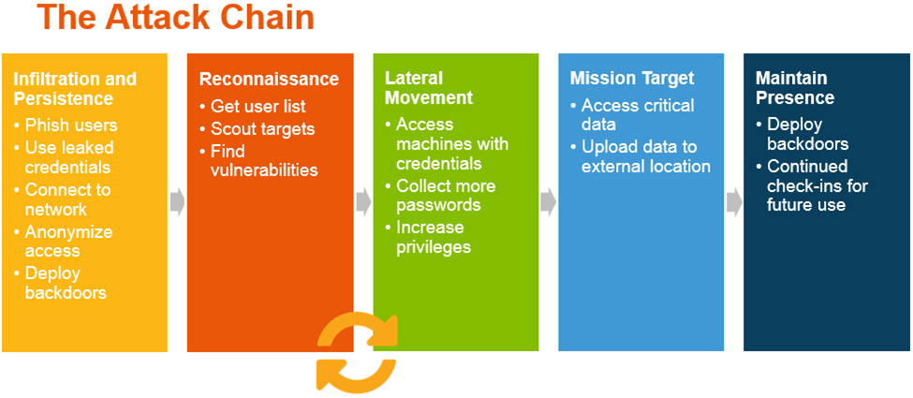
Detecting Lateral Movement
On graph of point-to-point logins (ssh, RDP), calculate maximum independent set (largest set of non-adjacent vertices)
As point-to-point logins explore more of the enterprise network, MIS shrinks
Can be used as another indicator of lateral movement
https://blog.rapid7.com/content/images/post-images/53326/the-attack-chain.png

Slide 6
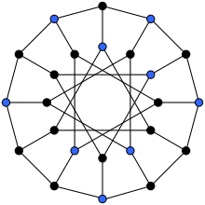
Maximum Independent Set (MIS)
An independent set is a set of vertices in a graph, no two of which are adjacent. A maximum independent set is an independent set of largest possible size for a given graph G.
NP-hard problem
For exact solutions, a set is independent if and only if its complement is a vertex cover. Therefore, the sum of the size of the largest independent set α(G) and the size of a minimum vertex cover β(G) is equal to the number of vertices in the graph.
The nine blue vertices form a maximum independent set for the Generalized Petersen graph GP(12,4)
https://en.wikipedia.org/wiki/Independent_set_(graph_theory)#Finding_maximum_independent_sets

Slide 7
Looking for a Good Graph Size Good == both relevant to large enterprise networks and feasible
#IP addresses full (|V|) | #IP addresses reduced | #point-to-point logins (|E|) | MIS size | time (s)
75571 | 1682 | 1474 | 1353 | 5.2
75571 | 3388 | 1474 | 3253 | 22.0
75571 | 21388 | 1474 | 21253 | 908.9
84718 | 84718 | 1239 | ? | > 18 hours
130176 | 8429 | 11782 | 7964 | 121.8
159931 | 11757 | 19943 | 11152 | 248.5
75571 | 3388 | 1474 |  | (using QPU) yyy
LANL data, not known to contain lateral movement: https://csr.lanl.gov/data/2017.html
88 days of data; focused on first 8; used 4-day sliding time window
Timings are averages of 5 timesteps except time-limit-exceeded
Running classically
Notes:
Need to understand whether the data we have represents a “good” graph size
#IPaddrs ~= sizes of enclaves of cloud-computing providers
Noticing that |E| is much smaller than |V|, collapsed singleton Vs to understand how that reduces compute time; need to vary |E| too
So, have G sizes that motivate being able to calculate MIS faster, and appears that enterprise-network-size Gs are feasible depending on |E|

Slide 8
Looking for a Good Graph Size
A quantum computer can only achieve exponential speed-up for a problem that wholly executes on it
Bigger-than-chip solvers can work for somewhat larger problems, but not for vastly larger problems
classical
near-term quantum
Time
eventual quantum
sweet spot
Problem size
Notes:
NP-hard algs take exponentially growing time for bigger problems
QCs take ~constant time for problems that fit
but users will not want to be limited to problems that fit
but solving vastly larger problems will again be limited by classical exponential time
If QPU solves 10% of problem, 2¹⁰ combinations of those may be feasible
If QPU solves 1% of problem, 2¹⁰⁰ combinations is not feasible

Slide 9
Analytic Finds Smaller MIS Size
spr_mbp:10M $ /Users/sreinhardt/technical/app_code/cyberGraph/process3.py netflow netflow --nTimesteps 8 --nTimestepsPerDay 4 --inputFormat LANL --inputDigested --verbose --reduceGraph
for timestep 3, the number of IP addresses in the full graph is 84718 and the number of IP-address-pairs that had point-to-point logins is 1239; the number of IP addresses in the reduced graph is 21178 and IP-address-pairs pt2pt is 1239
first MIS took 0:11:25.255169, second MIS took 0:17:05.962103
MIS size decreased from 21178 to 21059 (119) when ssh/telnet/RDP log-ins considered
IP addresses that are no longer part of the maximum independent set are ['ActiveDirectory', 'Comp005825’, […]
for timestep 4, the number of IP addresses in the full graph is 82543 and the number of IP-address-pairs that had point-to-point logins is 1472; the number of IP addresses in the reduced graph is 21380 and IP-address-pairs pt2pt is 1472
first MIS took 0:13:12.690244, second MIS took 0:14:24.761931
MIS size decreased from 21380 to 21245 (135) when ssh/telnet/RDP log-ins considered
IP addresses that are no longer part of the maximum independent set are ['ActiveDirectory', 'Comp005825’, […]
for timestep 5, the number of IP addresses in the full graph is 82266 and the number of IP-address-pairs that had point-to-point logins is 1525; the number of IP addresses in the reduced graph is 21427 and IP-address-pairs pt2pt is 1525
first MIS took 0:11:10.267566, second MIS took 0:11:31.594414
MIS size decreased from 21427 to 21294 (133) when ssh/telnet/RDP log-ins considered
IP addresses that are no longer part of the maximum independent set are ['ActiveDirectory', 'Comp005295’, […]
for timestep 6, the number of IP addresses in the full graph is 66069 and the number of IP-address-pairs that had point-to-point logins is 1551; the number of IP addresses in the reduced graph is 21459 and IP-address-pairs pt2pt is 1551
first MIS took 0:11:06.538207, second MIS took 0:17:56.528730
MIS size decreased from 21459 to 21317 (142) when ssh/telnet/RDP log-ins considered
IP addresses that are no longer part of the maximum independent set are ['ActiveDirectory', 'Comp005295’, […]
Notes:
Shifting back to current implementation, with the LANL data running classically, the output of the analytic shows the size of the reduced graph, the |pt2pt| (i.e., #edges), and the decrease in MIS size when pt2pt Es are added to the graph. As expected, as |pt2pt| grows, MIS size shrinks. (more precisely, the decrease in MIS size grows.)

Slide 10
Next Steps
Code available via private Github repository
Need to verify on data known to have lateral movement
Looking for collaborators, esp. with data
Notes:
***Needs a strong summary of work to date here

Slide 11
Agenda
Detecting lateral movement via maximum independent set
Achieving high performance with graph kernels on a D-Wave quantum computer
Implications for cyber analyses

Slide 12
Two Main Paths to Quantum Computing
Gate-model architecture
Significant theoretical work since 1985, key algs defined in 1990s
Major issue of error correction identified by Preskill in 1998
Believed to require 100-1000 physical qubits for every logical qubit
In early 2018, Google announced system with 72 physical qubits, results TBD
Digital nature in question
Preskill: “noisy intermediate-scale quantum” (NISQ) computers
Current focus on approximate optimization algs (e.g., QAOA)
Quantum-annealing architecture
Nishimori (1998) and Farhi (1999) described theory to find low energy states; Rose (2004) identified path to build such systems
D-Wave (2010+) has delivered 4 generations of systems, the latest with 2000 qubits
Academic knowledge is mostly empirical
Problems friendly to D-Wave topology show ~1000X advantage; real-world problems ~parity
New system generations every ~2yr
Notes:
GMQC
Mention Shor’s alg
Call out that Microsoft’s technology is expected to avoid EC issue
QA
We at D-Wave believe that our systems are moving much closer to the point of delivering differentiated performance and making people who deploy systems, like most of you here, care about them.

Slide 13
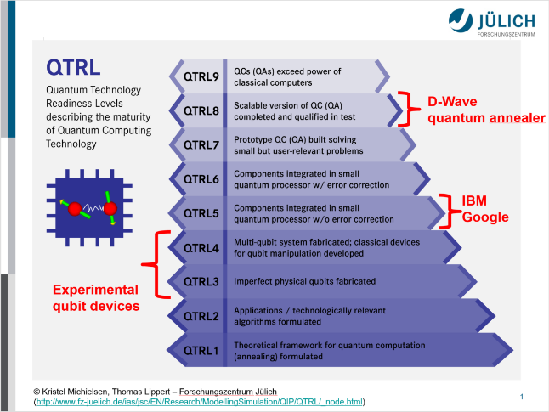
Notes:
And it’s not just us. Researchers at Julich, one of Europe’s most respected HPC labs, have been evaluating QC systems for the last several years, and they recently published this QTRL scale and their view of today’s reality. They show the experimental qubit devices at a QTRL of 3-4, the IBM and Google systems at a QTRL of 5, and D-Wave’s quantum annealer at a QTRL of 8, defined as “scalable version completed and qualified”. The thing that remains for us to do is deliver differentiated performance….

Slide 14
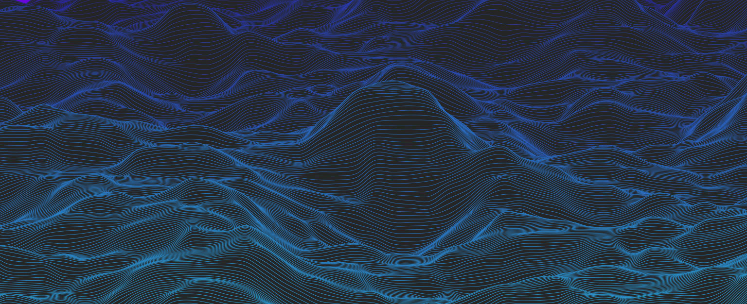
Quantum Annealing: How a D-Wave system works
Notes:
Put up a vast landscape. Talk about 2^1000 possibilities, how big that number is. This is 3D but could be multi-dimensional.
Overlay red dots all over the landscape in one shot. For some hard problems, classical has to explore each spot sequentially.
Remove red dots overlay and flash one red dot representing the answer. QC considers all possible answers in one shot
User maps a problem into search for “lowest point in a vast landscape”
System processes an enormous search space (ex. 2 ²⁰⁰⁰ ) with one instruction
Processor considers all possibilities simultaneously, finds lowest energy solutions
Multiple solutions returned to the user, sorted by optimal probability

Slide 15
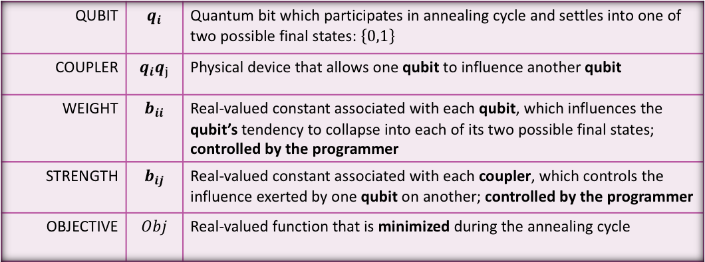
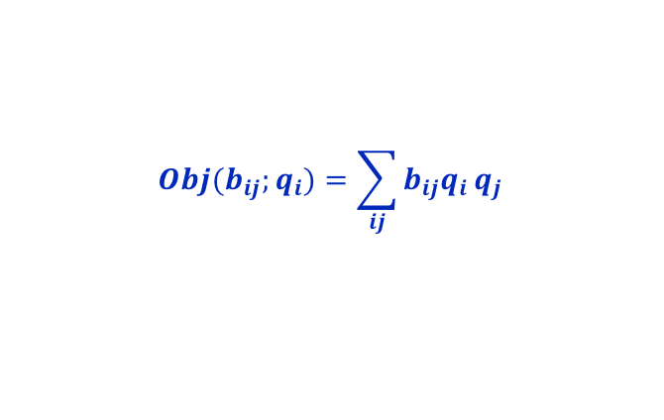
Programming Model / Quantum Machine Instruction
QUBIT | $$q_{i}$$ | Quantum bit which participates in annealing cycle and settles into one of two possible final states: $\left\{0,1\right\}$
COUPLER | $$q_{i}q_{j}$$ | Physical device that allows one qubit to influence another qubit
WEIGHT | $$b_{ii}$$ | Real-valued constant associated with each qubit, which influences the qubit’s tendency to collapse into each of its two possible final states; controlled by the programmer
STRENGTH | $$b_{ij}$$ | Real-valued constant associated with each coupler, which controls the influence exerted by one qubit on another; controlled by the programmer
OBJECTIVE | $$Obj$$ | Real-valued function that is minimized during the annealing cycle
Known as
- Quadratic unconstrained binary optimization (QUBO) problem
- Ising model
- Unconstrained binary quadratic problem (UBQP)
- Probabilistic graphical model (PGM)
$$Obj(b_{ij};q_{i})=\sum_{ij}{b_{ij}q_{i}}q_{j}$$
The system samples from the $q_{i}$that minimize the objective
Notes:
***NEED TO SAY “QUBO” HERE
***”How many of you woke up this morning thinking “Wow, if I only had a great way to execute QUBO problems I’d be set!”?”
Use analogy here: think of a qubit like one end of a see-saw, which can either be up (1) or down (0).
When you put a positive weight (e.g., sand bag) on the see-saw, the end goes down (0).
When you put a negative weight (e.g., helium balloon) on the see-saw, the end goes up (1).
This sampling turns out to be high value …

Slide 16
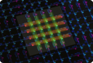
Mapping a Problem to D-Wave
Original form (e.g., constraints, graph (DNX))
Steps
Best known methods
Reduce problem size
Map to QUBO form
Avoid O(N²) #var growth
Reduce QUBO
Find frozen variables
Decompose QUBO
Various: energy impact, recomb elite
QUBO
Embed into HW graph
Avoid long chains, extend pre-embed
Tolerate low precision
Bin values into discrete ranges
HW-compliant QUBO
Adjust chain strength
Start with algebraic setting
Reverse spins
Use dozen(s)
Change anneal offsets
Delay chains as f(length)
Use reverse annealing
QPUs
Post-process
Notes:
- Embed: for topology w maxDegree(6), think of V w degree 10 …

Slide 17
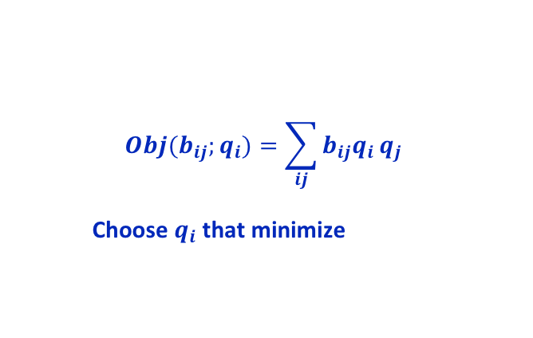
Mapping MIS to QUBO Form
0
1
2
3
-1, if i = j
b_{ij}
3, if i < j and ij E
⍦
4
5
6
7
0, otherwise
8
9
10
11
0 1 2 3 4 5 6 7 8 9 10 11
0
1
2
3
4
5
6
7
8
9
10
11
-1 3 3 3
-1 3 3 3
-1 3
-1 3 3
-1
$$Obj(b_{ij};q_{i})=\sum_{ij}{b_{ij}q_{i}}q_{j}$$
Choose $q_{i}$ that minimize
-1 3 3
-1 3 3
-1
-1
-1 3
-1
-1
https://canvas.auckland.ac.nz/courses/14782/files/563551/download?verifier=mGDAXoF3TDAKoZfnjmQ1WBRfjlB0LkTc62wAdyGO&wrap=1
Notes:
Let’s think through how we could map maximum independent set to a QUBO form. Remember what that form looks like, and that we’re minimizing the objective function. Our job is to pick the b-sub-ijs that will cause the q-sub-is to represent an MIS.
We can think of the problem as balancing two effects: we want to have vertices in the MIS, so let’s give a reward of -1 for elements on the diagonal. We want to penalize choosing two vertices that are adjacent, so we put a 3 in those positions.
Looking at the QUBO, I want to emphasize a couple things. First, the QUBO is the same size as the number of vertices N in the graph, not N^2 or something. Second, the density of the QUBO exactly reflects the density of the graph. Both of these attributes make MIS a good problem for solving as a QUBO.

Slide 18
Mapping Traveling Salesperson to QUBO Form
Many formulations use “for vertex i at step k” approach, which creates a QUBO with O(N²) variables, which, for real-world problems, will be too big to get benefit from a QC
0
1
2
3
<<graph>>
4
5
6
7
8
9
10
11
$$Obj(b_{ij};q_{i})=\sum_{ij}{b_{ij}q_{i}}q_{j}$$
Choose $q_{i}$ that minimize
0 1 2 3 4 5 6 7 8 9 10 11

Slide 19
Explicitly Hybrid Quantum/Classical MIS Kernel
A la Chapuis et al., CPU/GPUs and QPUs have drastically different natures; use each for its strengths
Unconnected vertices are placed in wholeMIS
For each connected component no bigger than N vertices, calculate MIS classically and add to wholeMIS; start with N=2
For each remaining connected component, calculate MIS and add to wholeMIS
Chapuis, Djidjev, Hahn, and Rizk, “Finding Maximum Cliques on the D-Wave Quantum Annealer”

Slide 20
Delivering Differentiated Performance
Today (D-Wave 2000Q™): In practice, problems of ~64 variables fit on the QPU
Next-gen D-Wave system targeted at 4-5K qubits with denser topology
Some problems shift from classically tractable to intractable between 64 and 326 variables: e.g., Markov networks (~50 today; 100s intractable)
Aspect | Change | Effect on #variables in QMI | Notes
More qubits | 2-2.5X more | * 1.4-1.6
Denser topology | 2.5X more | * 2.8 | Higher perf due to shorter chains
QA changes | TBD |  | Lower noise, ♢
Better algs/tools |  | * 1.3 | e.g., RBC embedding
Aggregate change |  | * 5.46 == 326 vars
♢ Roy et al.’s “Boosting integer factoring …” showed that per-qubit advance/delay of annealing in some cases led to a 1000X performance increase (i.e., fraction of valid results)
Notes:
64vars today, maybe a bit more
Factors: …; 326 vars; simplistically, compute power grows exponentially with #vars, so going from 64 to 326 is a huge step forward. Early adopters have confirmed our evidence that this will be a dramatic increase in compute power.
- maybe it’s better to think of problems that are tractable at 64 variables and intractable at 325. An example of that is Markov networks.
Fighting chance to deliver differentiated performance with next-gen system due next year
2^64 to 2^326; the 5.46 is really an exponent; the power of the DW2K^5.46

Slide 21
Agenda
Detecting lateral movement via maximum independent set
Achieving high performance with graph kernels on a D-Wave quantum computer
Implications for cyber analyses

Slide 22

Cyber Use Cases for Min Vertex Cover (MVCov)
In wireless sensor network, MVCov⁺ equates to a plan for installing a patch that minimizes the #rounds while preserving full observability throughout https://infoscience.epfl.ch/record/225623/files/EPFL_TH7484.pdf
MVCov is the optimal solution for worm propagation and hence for network defense Dharwadker and Pirzada, Applications of Graph Theory, ISBN 1466397098
MVCov⁺ finds minimal set of strings that occur in viruses but not in normal code https://math.mit.edu/~goemans/18434S06/setcover-tamara.pdf
To make the internet more robust, want better understanding of AS-level topology, but currently BGP data is being gathered from an incomplete and biased subset of ASes. MVCov⁺ calculates the minimum set of watching ASes that can supply data for a comprehensive view of the internet. https://isolario.it/extra/publications/papers/BGPIncompleteness.pdf
https://www.flaticon.com/free-icon/thumb-up_13979#term=thumbs up&page=1&position=86
Notes:
MVCov⁺ are actually set covers, which expands the problem more (in the conversion to QUBO) than vertex cover; O(N log(#sets))
http://docplayer.net/1332506-Mathematical-engineering-technical-reports-cyber-security-analysis-of-power-networks-by-hypergraph-cut-algorithms.html

Slide 23
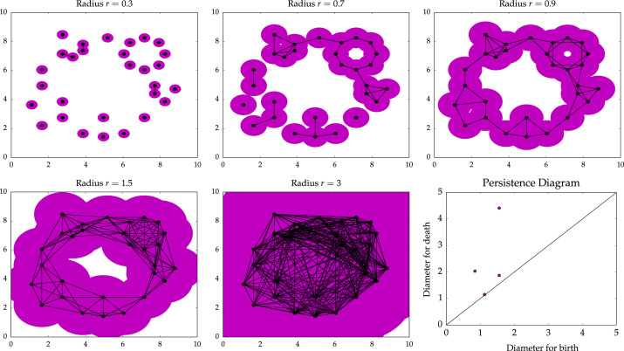
Related Use Case: Topological Data Analysis (TDA)
E. Munch: “Find and quantify structure in noisy, complex data.”
TDA’s Mapper capability commercialized by Ayasdi
Persistent homology capability highlights the "relative prominence of homological features in the data set”
Notes:
<figure descr>:
the ”persistence” (duration across a range of circle sizes) of the “homology” (higher-level structure) is what this identifies.
persistence diagram charts this persistence; short-lived structures are close to the diagonal and tend to be less interesting; longer-lived structures are off the diagonal and tend to be more interesting.
note that the graphs on which we execute PH can be derived, so the features/dimensions can be any aspect of the data we suspect will be interesting

Slide 24
TDA / Persistent Homology (cont.)
Believed to have high analytic value
E.g., used to identify features as targets for machine learning
Core kernels include:
Wasserstein (earthmover) distance between two distributions
Minimum clique cover
Smooth Euler characteristic transform
To date, min clique cover has been so expensive to compute that #dimensions analyzed is sharply limited, reducing analytic value
D-Wave implementation of Wasserstein distance by Berwald et al.
Exploring open-source release
Persistent homology’s ability to quantify structure in complex data appears a good match for cyber analysts’ need to understand complex, persistent attacks
J. Berwald, J. Gottlieb, E. Munch. Quantum Computation in a Topological Data Analysis Pipeline,
https://arxiv.org/pdf/1809.06433 https://www.dwavesys.com/sites/default/files/10_Tues_PM_TopPipe.pdf
Notes:
<last bullet>
AND, D-Wave will deliver the computational power to make it practically usable
- Wasserstein is O(N^3)

Slide 25
We used a quantum-capable compute-intense graph kernel to find lateral-movement-like behavior in netflow data. We expect near-term quantum acceleration for such graph kernels. We seek cyber-expert guidance for developing a new class of cyber tools exploiting these capabilities.

Slide 26
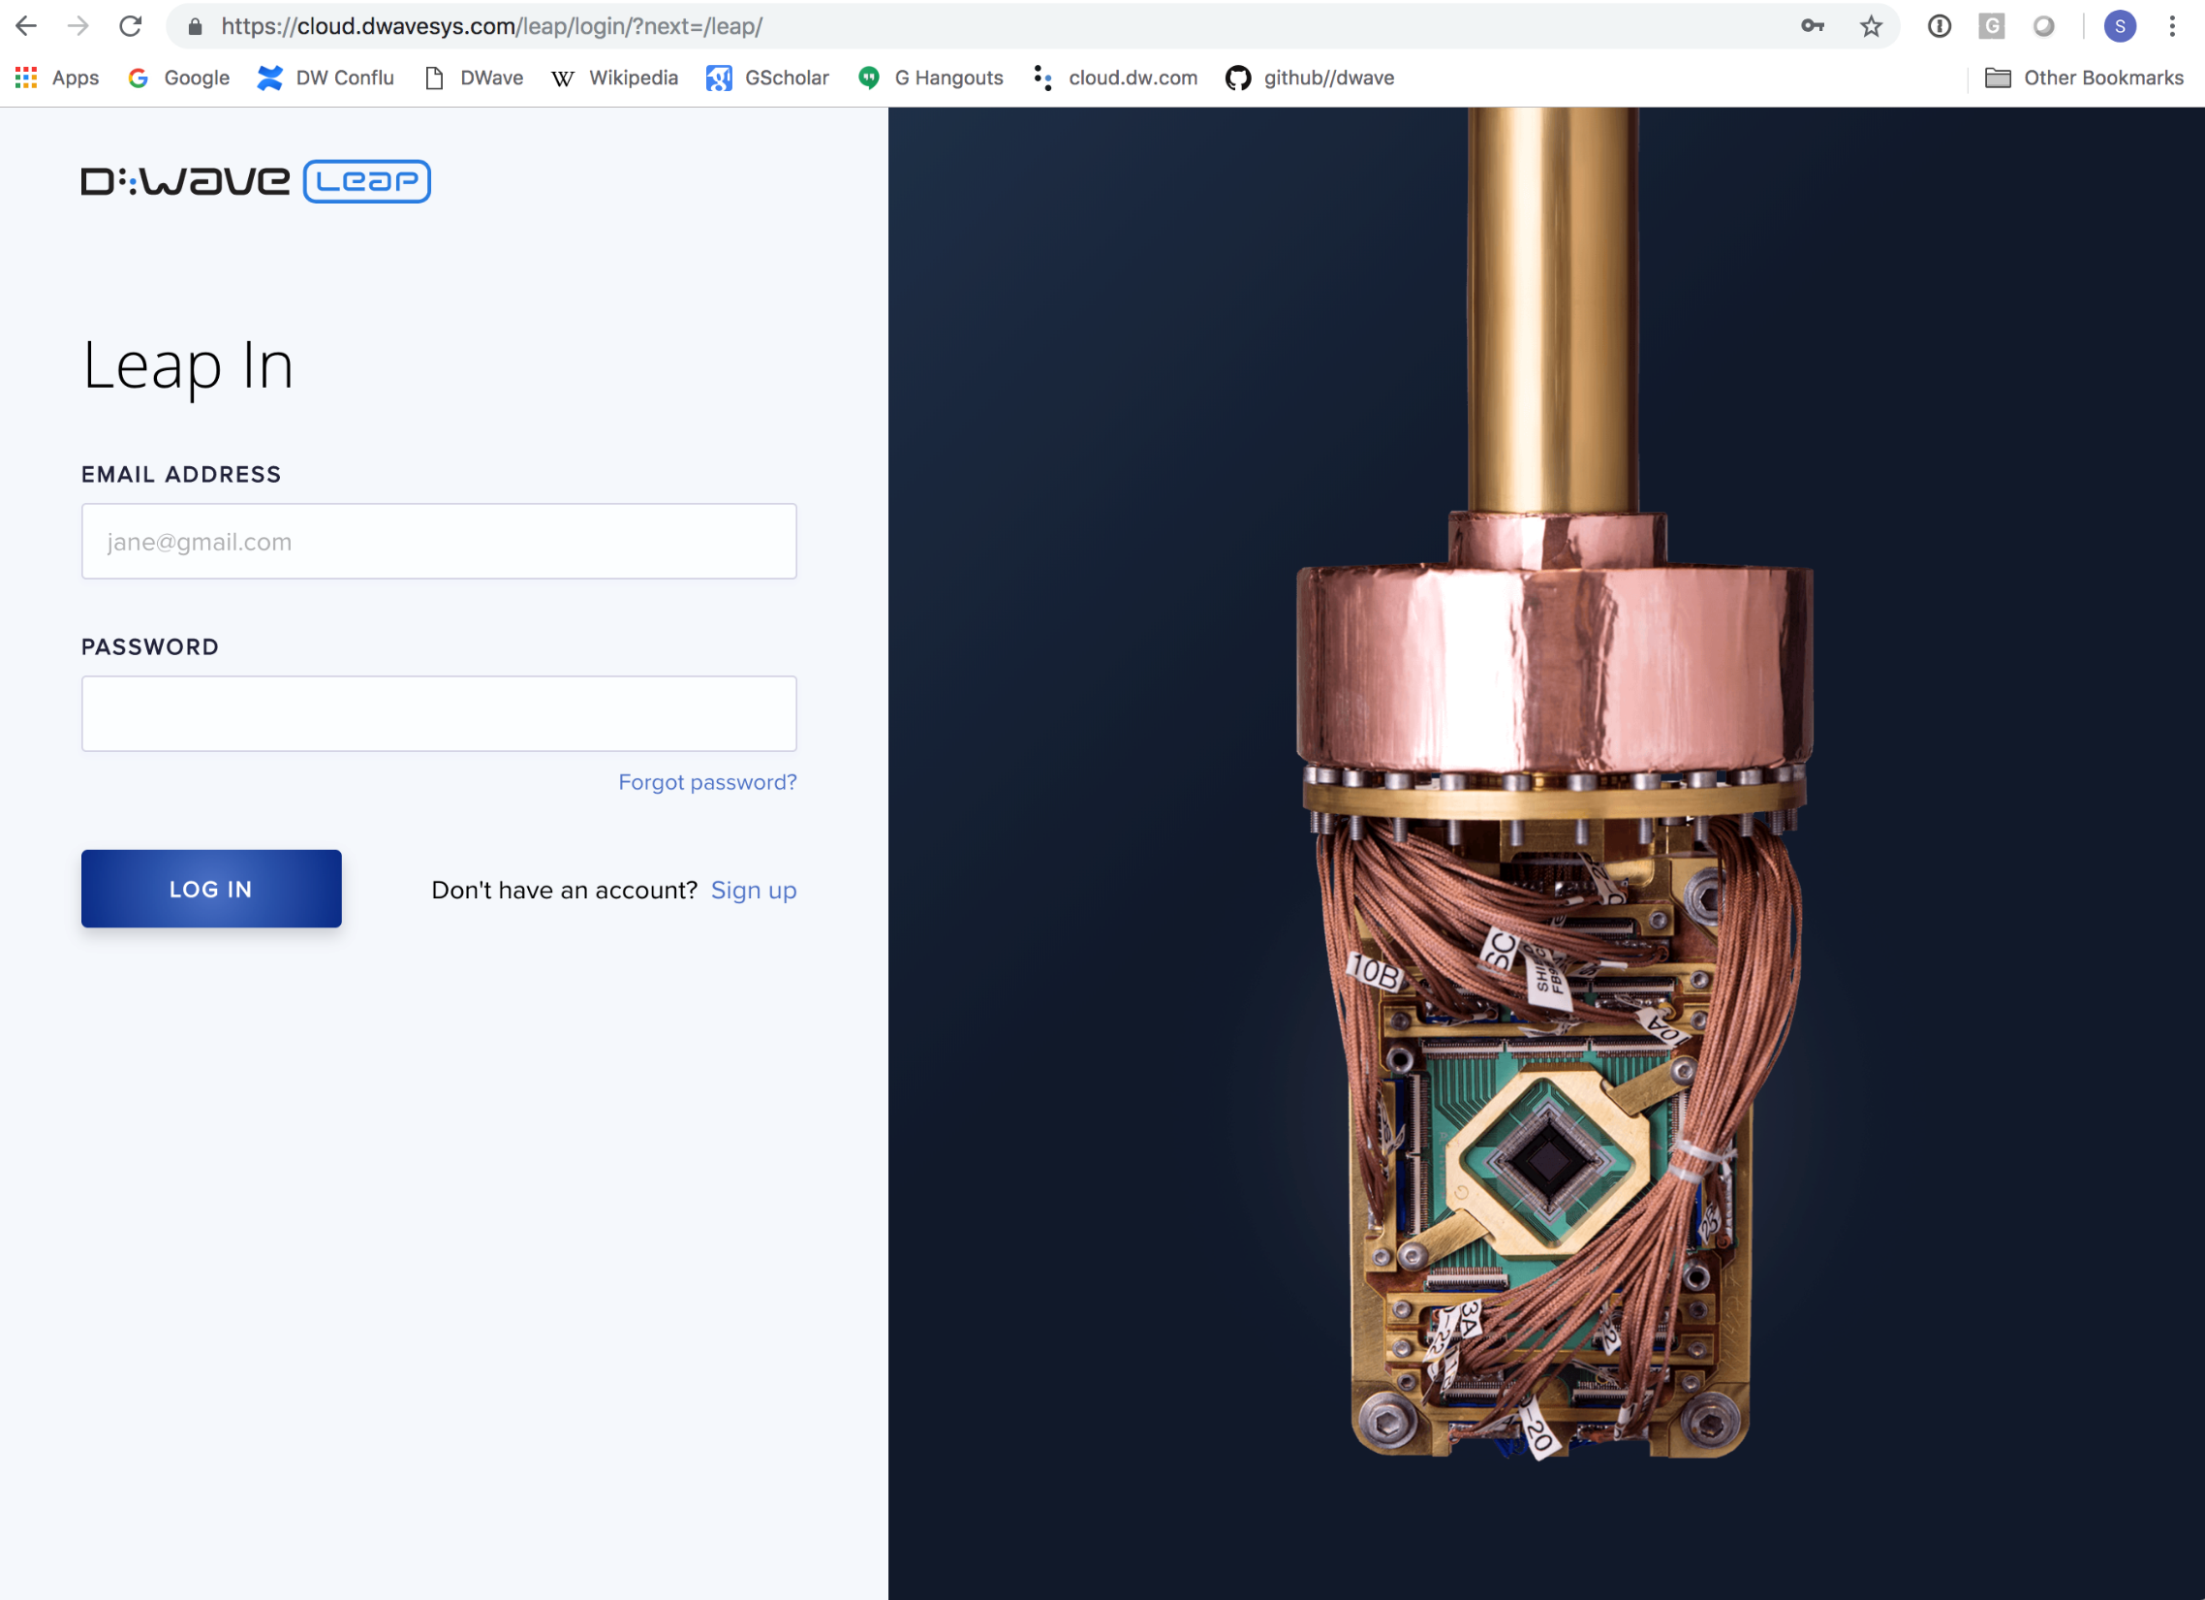

Slide 27
For More Information, See
D-Wave Users Group Presentations:
2018 (N.America): https://www.dwavesys.com/qubits-north-america-2018
2018 (European): https://www.dwavesys.com/qubits-europe-2018
2017: http://dwavefederal.com/qubits-2017/
2016: https://dl.dropboxusercontent.com/u/127187/User%20Group%20Presentations-selected/Qubits_User_Group_Presentations_Index.html
LANL Rapid Response Projects:
http://www.lanl.gov/projects//national-security-education-center/information-science-technology/dwave/index.php

Slide 28
Backup

Slide 29
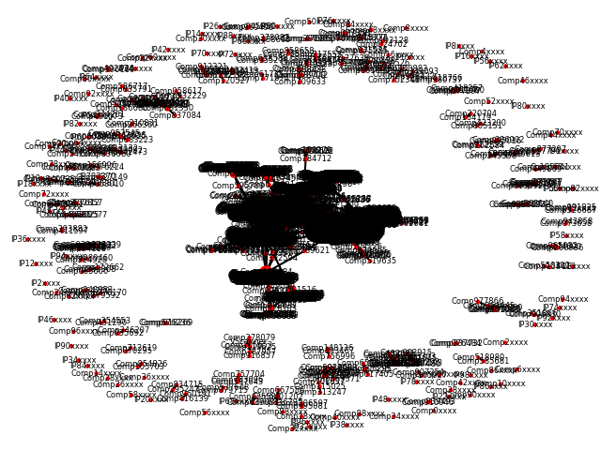
Preliminary Visualization
Notes:
Needs to be in the context of the cyber analyst, but this doesn’t get there.

Slide 30
Discussion
Why not use connected components (much faster)?
Could, but doesn’t give intuition about “how close to connected”
Need to find Goldilocks-size graphs
If too small, runs fast enough classically
If too big, even with medium-scale quantum acceleration, exponential algorithm still infeasible
If QPU solves 10% of problem, 2¹⁰ combinations of those may be feasible
If QPU solves 1% of problem, 2¹⁰⁰ combinations is not feasible

Slide 31
Cause for Optimism
NP-hard Problems Solved in Modern Compilers
Graph coloring
Set-weighted covering
Topological sort
Graph coloring
Minimal vertex covering
Maximum weighted path cover
Multiple graph partitioning
Code generation
Register sufficiency
Instruction scheduling
Register allocation, coalescing, minimizing spill, and reuse
Global reference allocation
Array unification
Distributed memory layout

